Slide 1
Scikits Iowa Alcohol Distributors - Machine Learning Project
AMIL WALGAMAGE, JAMIE TAN & TAS TUDOR

Slide 2


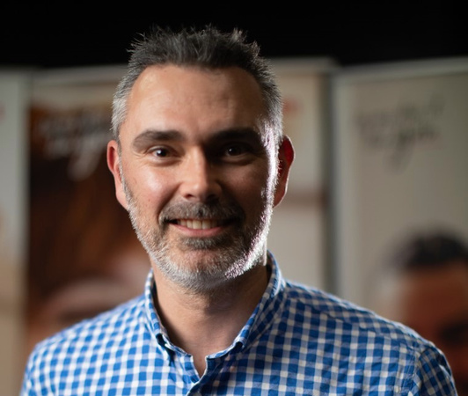
THE TEAM
Amil Walgamage
Jamie Tan
Tas Tudor

Slide 3

PROJECT SUMMARY
High Level:
Machine learning product recommender for wholesale liquor outlets in Iowa USA to increase conversion rates & revenue per customer.
Successfully Completed:
Built and deployed working machine learning website with a personalised product recommender based on data obtained from Google's machine learning public databases.
According to McKinsey:
35%
of consumer purchases on Amazon come from product recommendations^.
^ https://www.mckinsey.com/industries/retail/our-insights/how-retailers-can-keep-up-with-consumers

Slide 4



THE DATA - IOWA WHOLESALE LIQUOR RETAIL SALES 2012 - 2020
THE DATA
CHALLENGES
SOLULTIONS
Contains every wholesale purchase of liquor in the State of Iowa since 2012.
Very large data set
Google Colab solved VM issue
State controls the wholesale distribution.
Ideally wanted consumer data
Used Google's BigQuery to query the data
Contains the following details:
Images of products not in data
Scraped the images from the State of Iowa's Alcoholic Beverages Division website
Store details and location
The brands purchased
Dates
Invoice numbers
Quantity
Finding and using the appropriate Machine Learning Models
Found a popular Machine Learning Model - "Turicreate" (an Apple Open Source library)
Visualising the machine learning results data
Virtual Environment Required

Slide 5
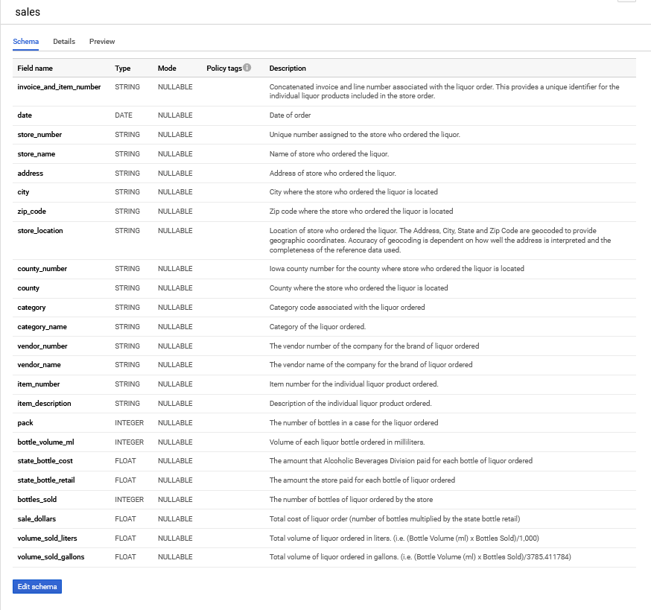
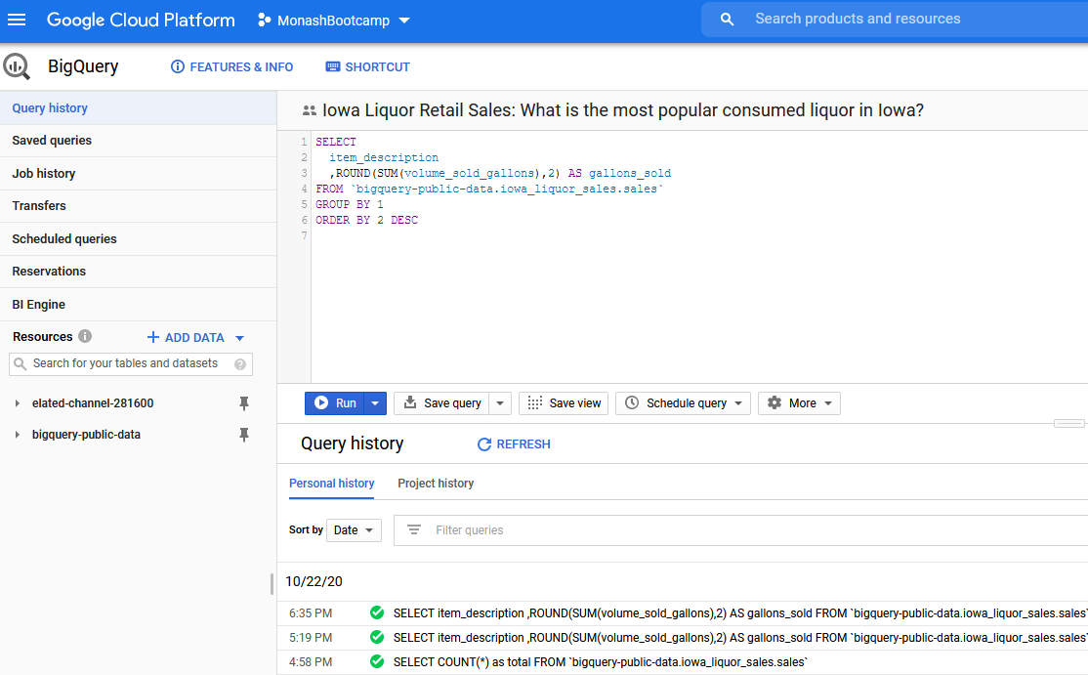
THE DATA
GOOGLE CLOUD PLATFORM

Slide 6
EXPLORATORY DATA ANALYSIS (EDA)
RECORDS FROM 1 JANUARY 2020
CUSTOMER LISTING
OTHER EDA
Stores of various sizes. eg Walmarts, Costco to mini-stores
Checked and cleaned for any null or duplicate values
Total number of transactions: 446,139
Each store of a large customer has it's own store ID
Removed un-wanted columns
Total number unique customers: 1,841
Volumes can exceed 300,000 litres purchased per store
Data was relatively clean for our purposes
Total number unique products: 3,846
Some stores have made over 1,750 purchases since 1 January
Outliers were not removed as data was normalised

Slide 7












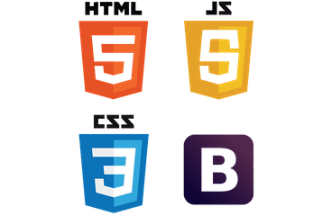






THE TOOLBOX
TOOLS & MACHINE LEARNING
VISUALISATIONS
SOURCES
WEB APP
CHARTING TOOLS
DESIGN & FRONT END

Slide 8

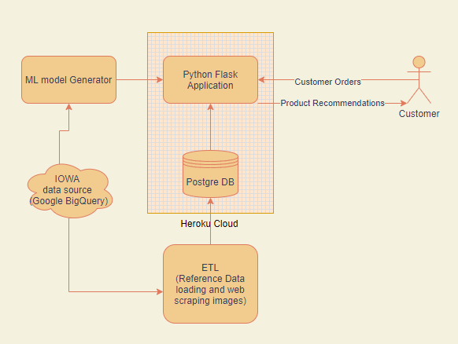

THE ARCHITECTURE

Slide 9
THE PROCESS FLOW
Load
Page
Select Existing
Returns Model Outcome
Front End App
CUSTOMER
Call Flask
Select New
Returns Model Outcome
Front End App
Call Flask
PRODUCT - NEW CUSTOMER
Select Product
Returns Model Outcome
Front End App
Call API
Call Flask

Slide 10
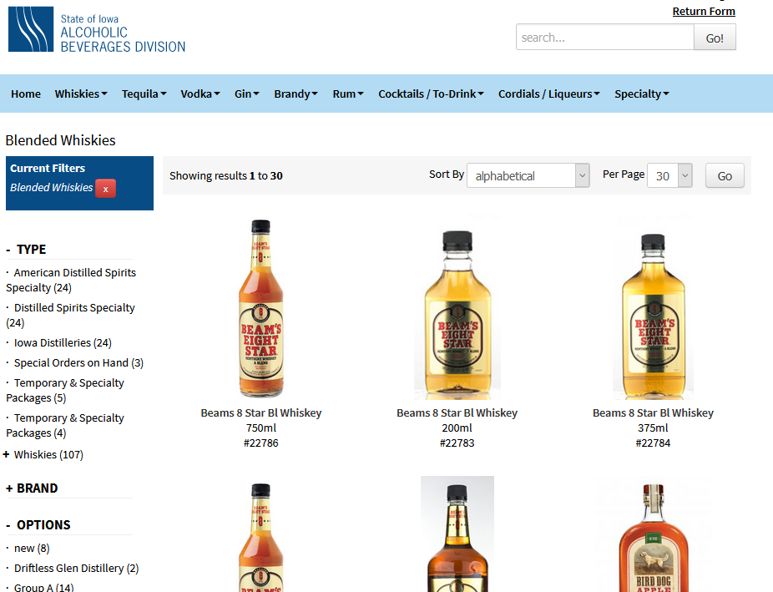
WEB SCRAPING
MISSING IMAGES
The data source did not contain any image links
Web Scraping was required through the Selenium Library to scrape from the Iowa Liquor Commission website

Slide 11



MACHINE LEARNING
The Learning Models (80/20)
3 Different Techniques
Popularity
Collaborative Filtering (Cosine
Similarity)
Collaborative Filtering (Pearson
Similarity)
Normalised
1 MILLION
2 MILLION
3 MILLION
3 Datasets
Dummy
4 MILLION
5 MILLION
6 MILLION
Purch Volume
7 MILLION
8 MILLION
9 MILLION

Slide 12




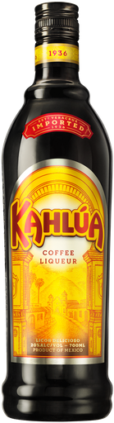
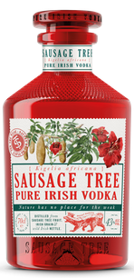
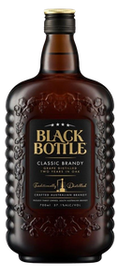
COLLABORATIVE FILTERING
I am Fred
I am Jane
SIMILAR BUYERS
BUY
BUY
BUY
RECOMMEND
BUY
BUY
Based on Fred's extra purchase, Jane is recommended a 3rd product as they purchase similar items

Slide 13
POPULARITY
No.1
Top Sales
No.2
Top Sales
No.3
Top Sales
recommend
recommend
I am Fred
Based on overall product popularity, Jane and Fred are recommended the same products
I am Jane

Slide 14
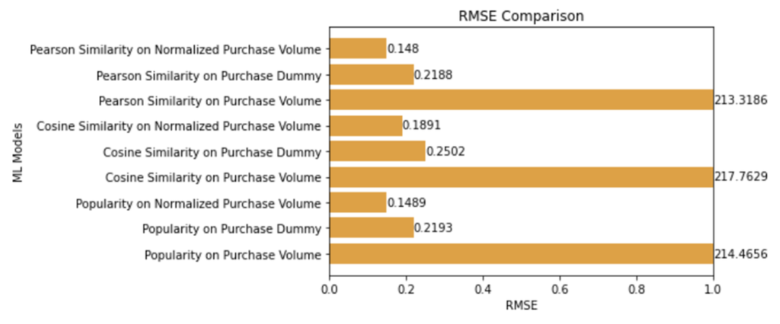
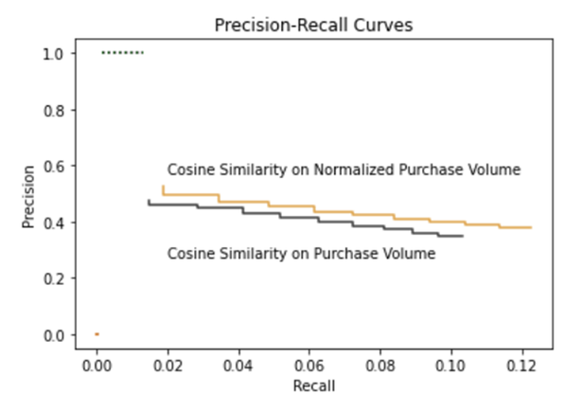
MODEL EVALUATION - V1

Slide 15
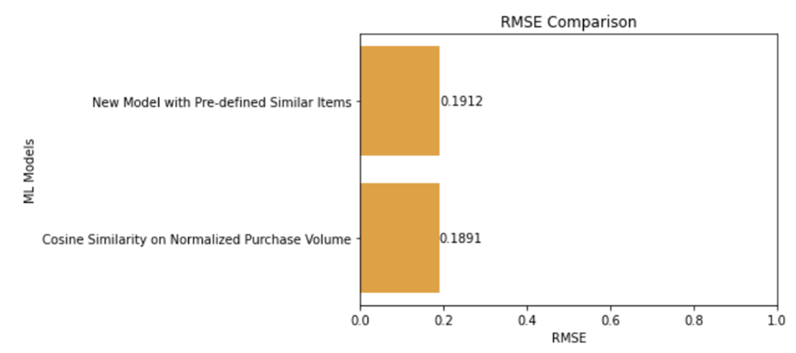
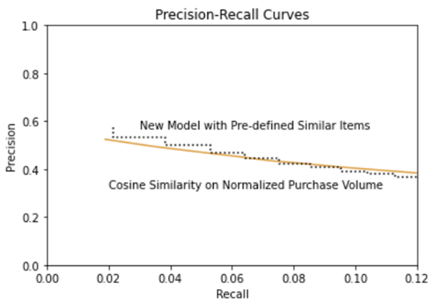
MODEL EVALUATION - V2

Slide 16
PROS & CONS OF THE MODEL
Pros
Cons
Fast and highly scalable - works with large datasets on a single machine
Difficulty in obtaining the data to visualise the outcome data (Turicreate)
Flexible - supports a wide range of data
Colloborative Filtering - minority points of view can dominate others
Easy to use - focus on the tasks, not the algorithms
New users may require sufficient data, ie "the cold start problem"
Deployment to the IOS ecosystem is ready
Needed to create a VM or WSL (Windows Subsystem for Linux) if a Windows user to do local debugging

Slide 17
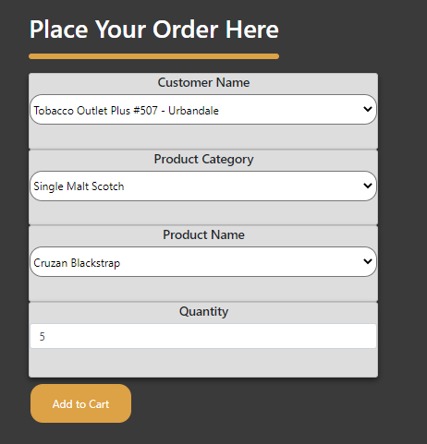
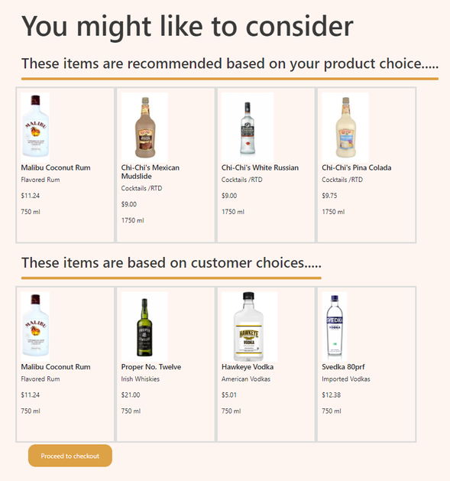

FRONT END
HTML / JAVASCRIPT / BOOTSTRAP / CSS
Built from scratch to include:
CSS Styling and media queries
Javascript call functions, filtering and loading
Successfully Responsive
Recommender working!
Deployed to GitHub & Heroku
250 plus commits

Slide 18



NICE TO HAVE'S & FURTHER DEVELOPMENT TO INCREASE CUSTOMER SPEND
Shopping Cart & Add Multiple Items
Apply continual learning to the Model
Evaluate the conversion rate / ROI
The model accepts multiple items to improve accuracy, but it isn't represent front end yet
New data to optimise the model to ensure relevance
Evaluate the model when it receives new data

Slide 19
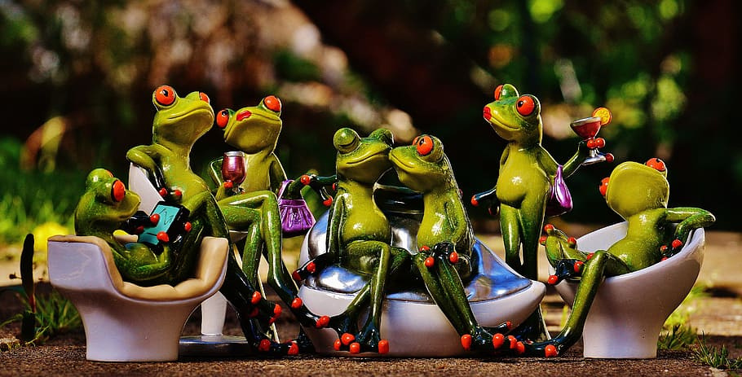
Thank You

